Slide 1
Week 7. Correlation and regression
PCA: Covariance matrix and correlation matrix
Scatterplot
Three frameworks for correlation coefficient
Naïve approach
Approximation: Correlation and determinacy; properties and meaning
Probability: Gaussian distribution
Weird correlation case studies
Different function and/or different criteria: Nature-inspired optimization
Homework 5

Slide 2
Week 7. In Principal Component Analysis: Conventional approach
* =
Covariance matrix:
Given a N×V data matrix X, compute its centered version Y and the V×V feature covariance matrix B:
Center matrix X by finding, for each feature, its mean and subtracting it from all the feature values, Y=X-m(X)
Compute square matrix A=Y′∗Y and divide it by N or N-1 (do the latter if you think that the result is going to be used as an estimate of the covariance matrix of a multivariate density function, I rather divide by N): B= Y′∗Y/N.
(v,w) entry in B: $b_{vw}=\frac{1}{N}\sum_{i=1}^{N}{(x_{iv}−\overline{x_{v}})(x_{iw}−\overline{x_{w}})}$

Slide 3
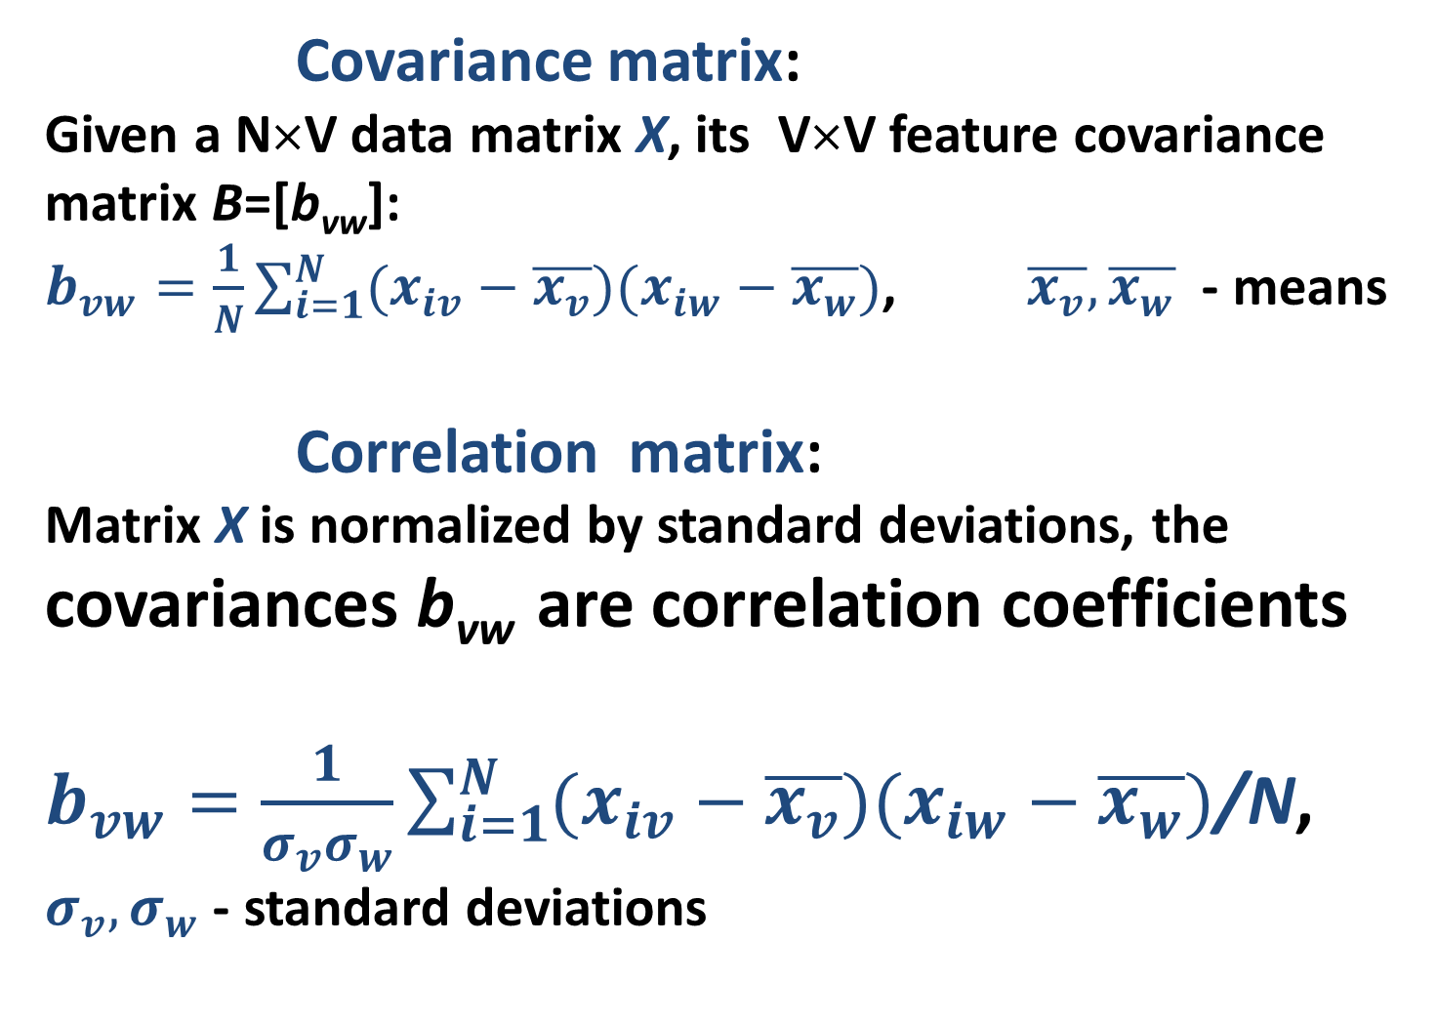
Week 5. Principal Component Analysis: Conventional approach, 3
* =
Covariance matrix:
Given a N×V data matrix X, its V×V feature covariance matrix B=[b_{vw}]:
$b_{vw}=\frac{1}{N}\sum_{i=1}^{N}{(x_{iv}−\overline{x_{v}})(x_{iw}−\overline{x_{w}})}$, $\overline{x_{v}},\overline{x_{w}}$ - means
Correlation matrix:
Matrix X is normalized by standard deviations, the covariances b_{vw} are correlation coefficients
$b_{vw}=\frac{1}{σ_{v}σ_{w}}\sum_{i=1}^{N}{(x_{iv}−\overline{x_{v}})(x_{iw}−\overline{x_{w}})}$/N,
$σ_{v}{, σ}_{w}$ - standard deviations

Slide 4
Week 7. Meaning of correlation
Illustrative: take two features
Company name | Income, $mln | MSha,% | Nsu | EC | Sector
Aversi Antyos Astonite | 19.0 29.4 23.9 | 43.7 36.0 38.0 | 2 3 3 | No No No | Utility Utility Industrial
Bayermart Breaktops Bumchist | 18.4 25.7 12.1 | 27.9 22.3 16.9 | 2 3 2 | Yes Yes Yes | Utility Industrial Industrial
Civok Cyberdam | 23.9 27.2 | 30.2 58.0 | 4 5 | Yes Yes | Retail Retail

Slide 5
Week 7. Meaning of correlation Scatterplot
Take two features
nam x y
Aver 19 43.7
Anty 29.4 36
Aston 23.9 38
Bayerm 18.4 27.9
Brea 25.7 22.3
Bumc 12.1 16.9
Civok 23.9 30.2
Cyber 27.2 58
MatLab Command:
>> plot(x,y,'b*'); text(x,y,nam); axis([10 35 15 60])

Slide 6
Week 7. Iris Scatterplots
Iris Sepal plot Petal plot
The views:
Do
differ!
Correlate?
MatLab:
>> subplot(1,2,1);plot(iris(:,1),iris(:,2),'b.');
>> subplot(1,2,2);plot(iris(:,3),iris(:,4),'b.');

Slide 7
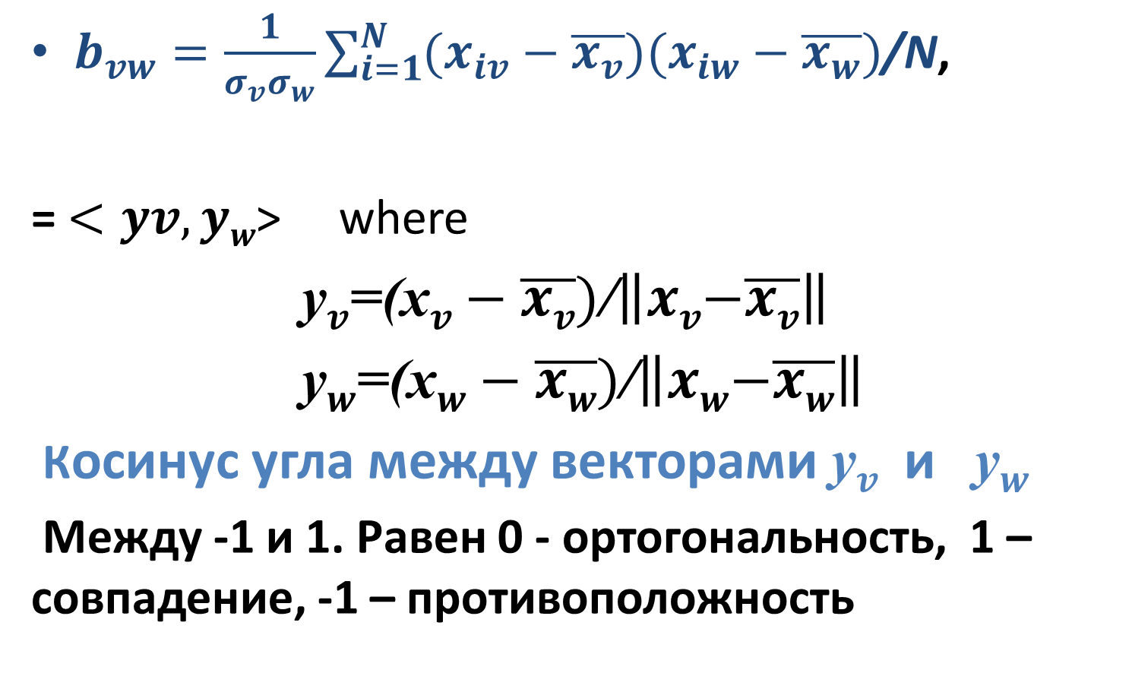
Week 7. Naïve interpretation of correlation
$b_{vw}=\frac{1}{σ_{v}σ_{w}}\sum_{i=1}^{N}{(x_{iv}−\overline{x_{v}})(x_{iw}−\overline{x_{w}})}$/N,
= $<yv,yw$> where
y$v$=(x$v−\overline{xv})$/$\left\|xv\left.−\overline{xv}\right\|\right.$
y$w$=(x$w−\overline{xw})$/$\left\|xw\left.−\overline{xw}\right\|\right.$
Косинус угла между векторами y$v$и y$w$
Между -1 и 1. Равен 0 - ортогональность, 1 – совпадение, -1 – противоположность

Slide 8
Week 7. Approximation interpretation of correlation

Slide 9
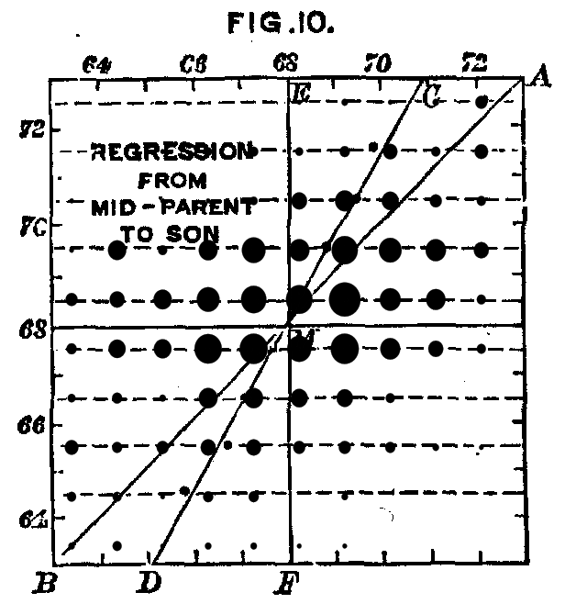
Week 7. 2D Linear regression 1
A bit of History
Francis Galton (1822-1911), another
grandson of Erasmus Darwin,
obsessed with the idea that
talent is inherited,
finds that the height of son
regresses to the mean,
from father’s height (1885) –
This explains the term.

Slide 10
Week 7. 2D Linear regression 2
Iris Petal Width: how can we express it
through Petal Length linearly
PeWi=a*PeLe+b

Slide 11
Week 7. 2D Linear regression 2
Iris How can we fit equation
PeWi=a*PeLe+b
Meaning of a:
a = Change in PeWi at PeLe
changed by 1
(slope)
b = expected PeWi at PeLe=0 (This requires a bit of fantasy,,,)
(intercept)

Slide 12
Week 7. 2D Linear regression 3
How can we express y=ax+b with minimum error? Maths:
At entity i=1, 2, . . ., N equation
y_{i} = ax_{i} + b + e_{i} where e_{i} is error, residual
Idea: Find a and b minimizing errors e_{i}

Slide 13
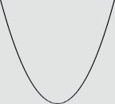
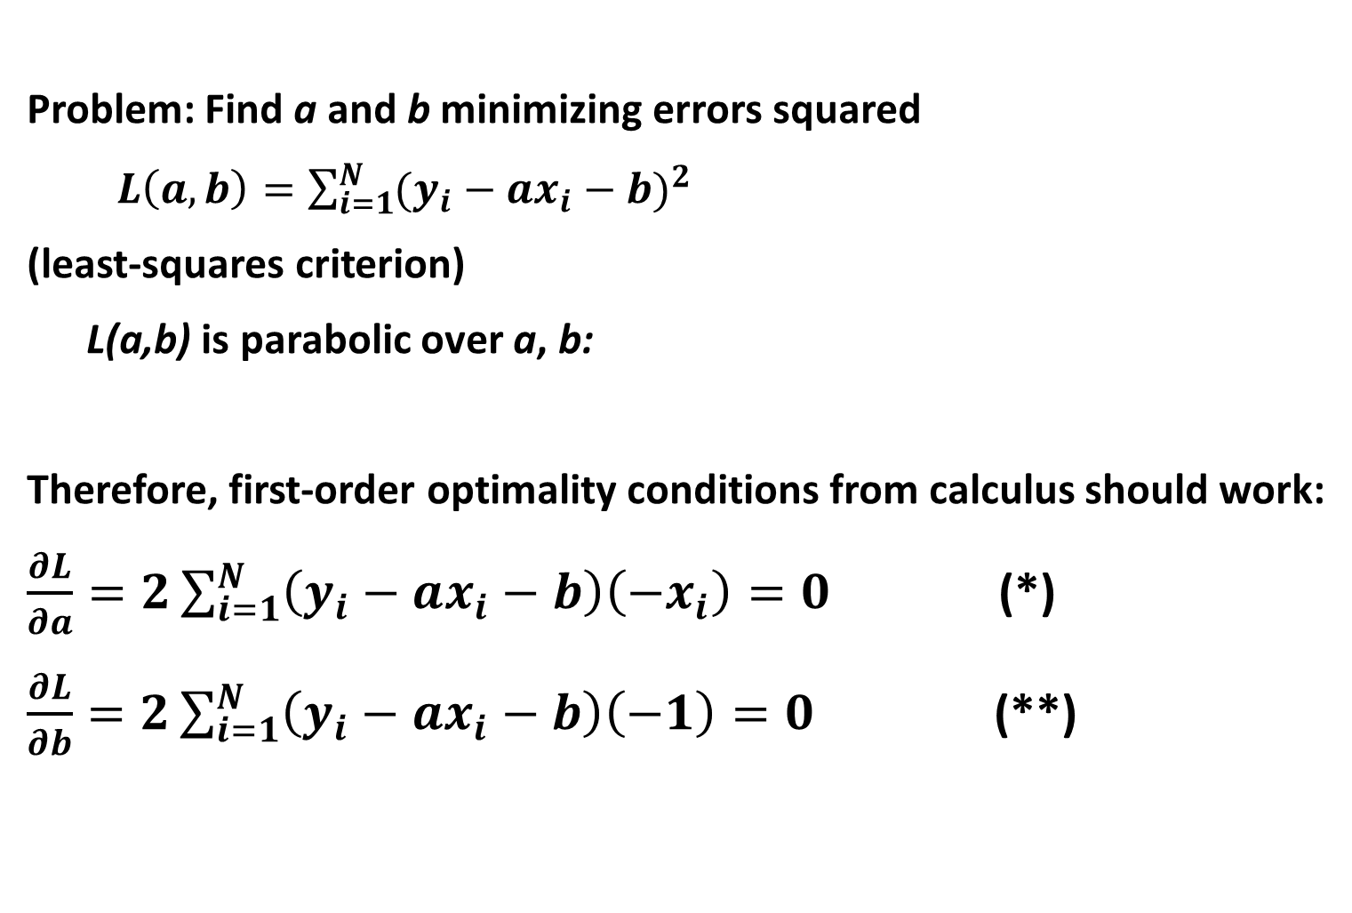
Week 7. 2D Linear regression 3
Problem: Find a and b minimizing errors squared
$L\left(a,b\right)=\sum_{i=1}^{N}{{(y_{i}−ax_{i}−b)}^{2}}$
(least-squares criterion)
L(a,b) is parabolic over a, b:
Therefore, first-order optimality conditions from calculus should work:
$\frac{∂L}{∂a}=2\sum_{i=1}^{N}{{\left(y_{i}−ax_{i}−b\right)\left(−x_{i}\right)=0}^{}}$ (*)
$\frac{∂L}{∂b}=2\sum_{i=1}^{N}{{\left(y_{i}−ax_{i}−b\right)\left(−1\right)=0}^{}}$ (**)

Slide 14
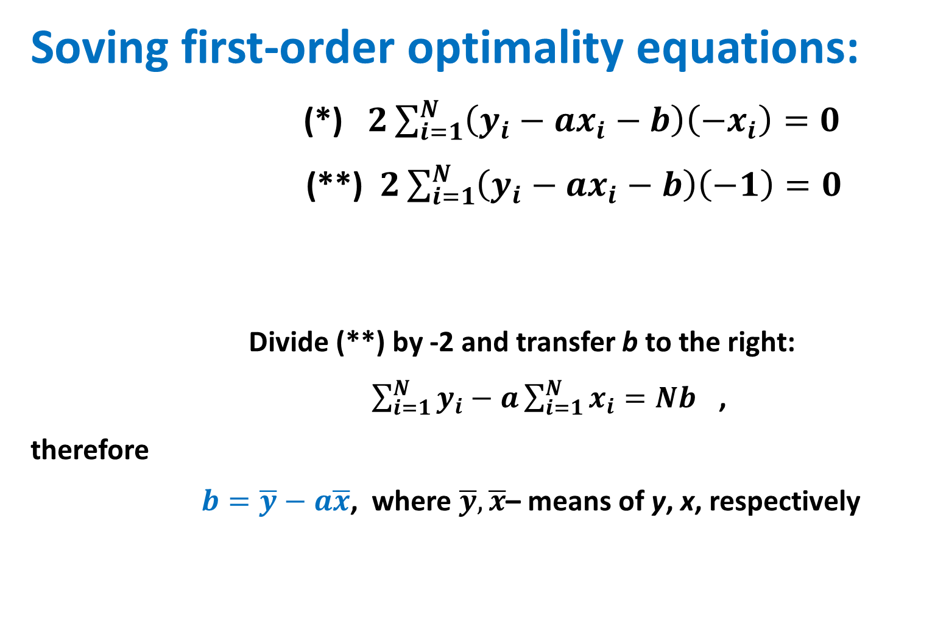
Week 7. 2D Linear regression 4
Soving first-order optimality equations:
(*) $2\sum_{i=1}^{N}{{\left(y_{i}−ax_{i}−b\right)\left(−x_{i}\right)=0}^{}}$
(**) $2\sum_{i=1}^{N}{{\left(y_{i}−ax_{i}−b\right)\left(−1\right)=0}^{}}$
Divide (**) by -2 and transfer b to the right:
$\sum_{i=1}^{N}{{y_{i}−a\sum_{i=1}^{N}{x_{i}}=Nb}^{}}$,
therefore
$b=\overline{y}−a\overline{x}$, where $\overline{y},\overline{x}$– means of y, x, respectively

Slide 15
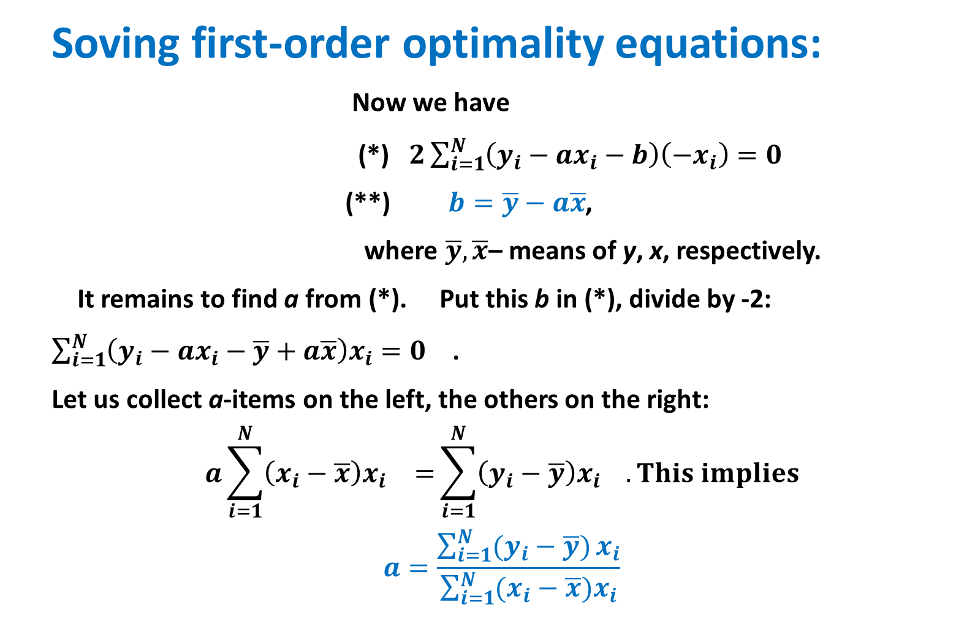
Week 7. 2D Linear regression 4
Soving first-order optimality equations:
Now we have
(*) $2\sum_{i=1}^{N}{{\left(y_{i}−ax_{i}−b\right)\left(−x_{i}\right)=0}^{}}$
(**) $b=\overline{y}−a\overline{x}$,
where $\overline{y},\overline{x}$– means of y, x, respectively.
It remains to find a from (*). Put this b in (*), divide by -2:
$\sum_{i=1}^{N}{{\left(y_{i}−ax_{i}−\overline{y}+a\overline{x}\right)x_{i}=0}^{}}$ .
Let us collect a-items on the left, the others on the right:
$$a\sum_{i=1}^{N}{{\left(x_{i}−\overline{x}\right)x_{i}}^{}=}\sum_{i=1}^{N}{{\left(y_{i}−\overline{y}\right)x_{i}}^{}}. This implies$$
$$a=\frac{\sum_{i=1}^{N}{(y_{i}−\overline{y})}x_{i}}{\sum_{i=1}^{N}{(x_{i}−\overline{x}})x_{i}}$$

Slide 16
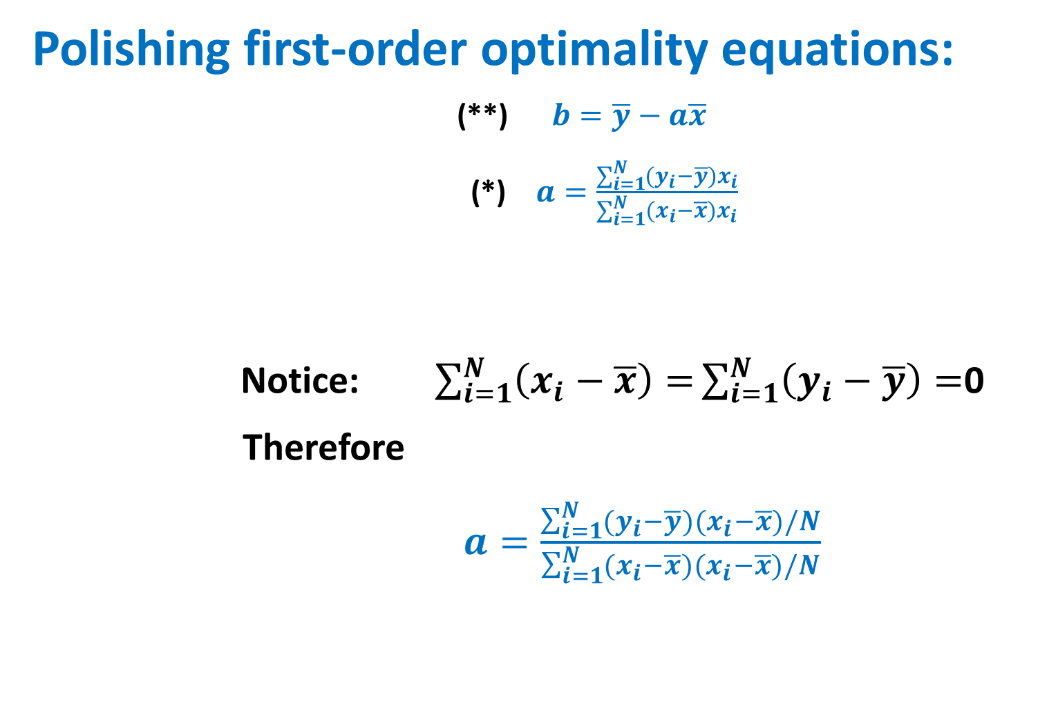
Week 7. 2D Linear regression 5
Polishing first-order optimality equations:
(**) $b=\overline{y}−a\overline{x}$
(*) $a=\frac{\sum_{i=1}^{N}{(y_{i}−\overline{y})}x_{i}}{\sum_{i=1}^{N}{(x_{i}−\overline{x}})x_{i}}$
Notice: $\sum_{i=1}^{N}{\left(x_{i}−\overline{x}\right)=}\sum_{i=1}^{N}{\left(y_{i}−\overline{y}\right)=}$0
Therefore
$a=\frac{\sum_{i=1}^{N}{(y_{i}−\overline{y})}{(x}_{i}−\overline{x})/N}{\sum_{i=1}^{N}{(x_{i}−\overline{x}}){(x}_{i}−\overline{x})/N}$

Slide 17
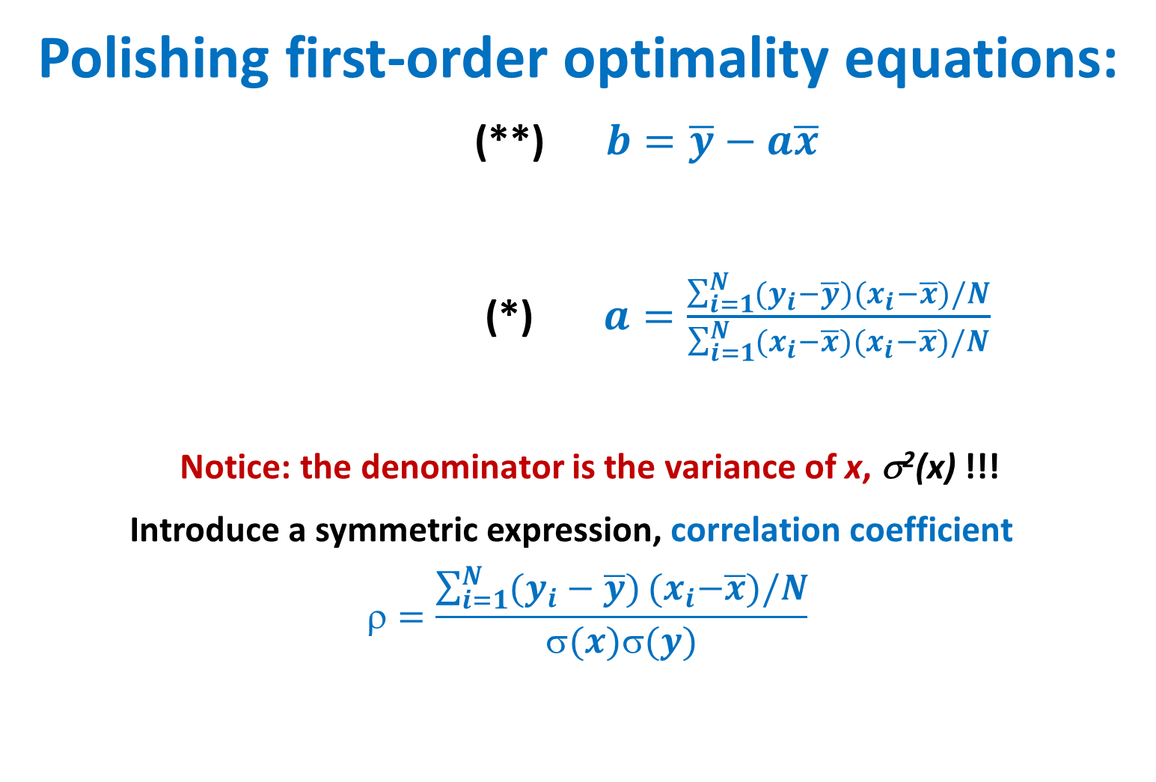
Week 7. 2D Linear regression 5
Polishing first-order optimality equations:
(**) $b=\overline{y}−a\overline{x}$
(*) $a=\frac{\sum_{i=1}^{N}{(y_{i}−\overline{y})}{(x}_{i}−\overline{x})/N}{\sum_{i=1}^{N}{(x_{i}−\overline{x}}){(x}_{i}−\overline{x})/N}$
Notice: the denominator is the variance of x, σ²(x) !!!
Introduce a symmetric expression, correlation coefficient
$$=\frac{\sum_{i=1}^{N}{(y_{i}−\overline{y})}{(x}_{i}−\overline{x})/N}{σ(x)σ(y)}$$

Slide 18
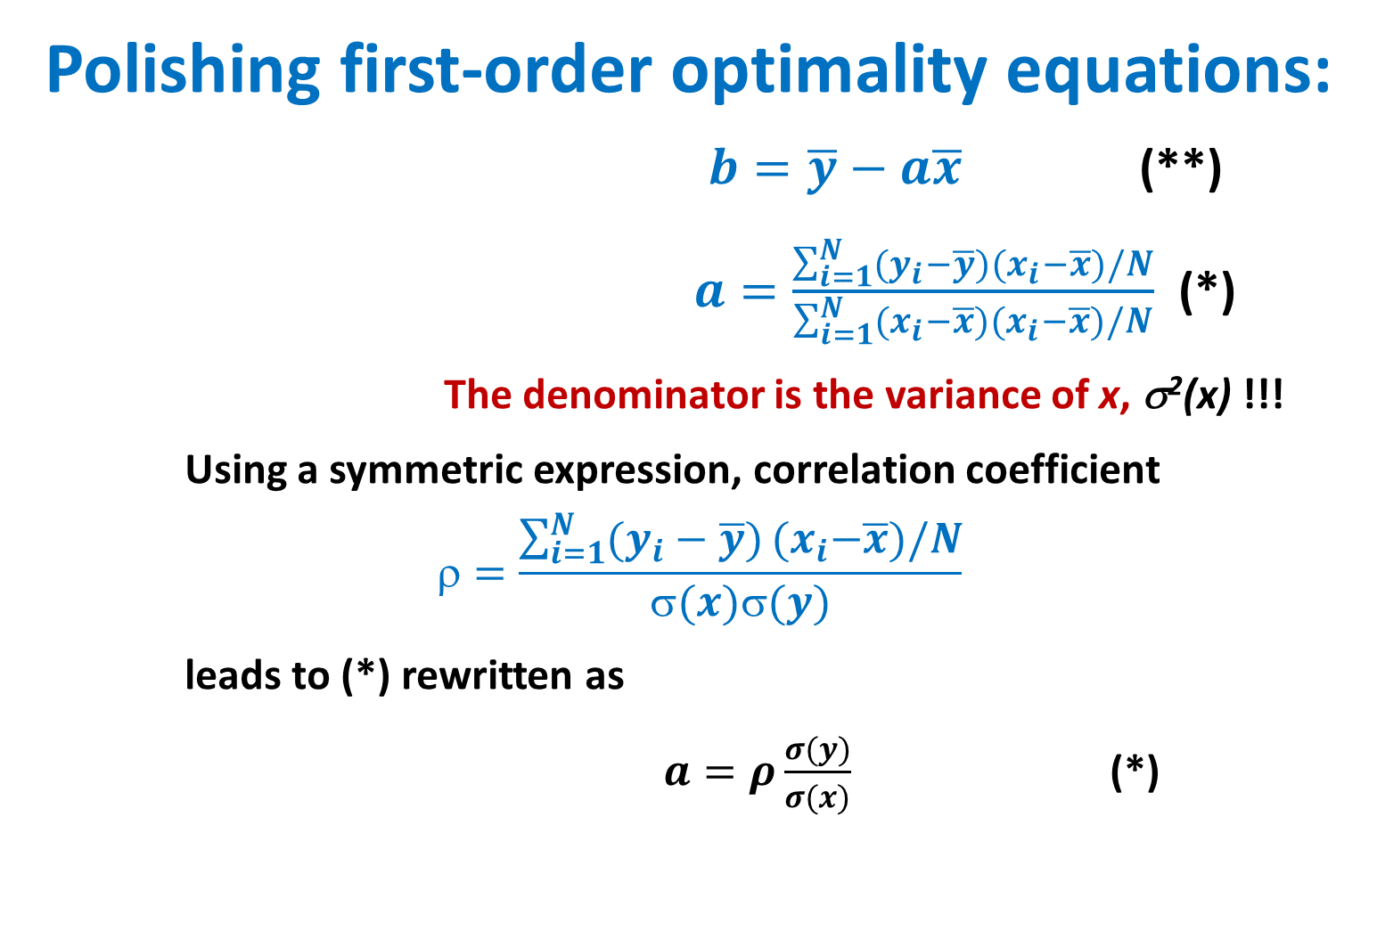
Week 7. 2D Linear regression 6
Polishing first-order optimality equations:
$b=\overline{y}−a\overline{x}$ (**)
$a=\frac{\sum_{i=1}^{N}{(y_{i}−\overline{y})}{(x}_{i}−\overline{x})/N}{\sum_{i=1}^{N}{(x_{i}−\overline{x}}){(x}_{i}−\overline{x})/N}$ (*)
The denominator is the variance of x, σ²(x) !!!
Using a symmetric expression, correlation coefficient
$$=\frac{\sum_{i=1}^{N}{(y_{i}−\overline{y})}{(x}_{i}−\overline{x})/N}{σ(x)σ(y)}$$
leads to (*) rewritten as
$a=ρ\frac{σ(y)}{σ(x)}$ (*)

Slide 19
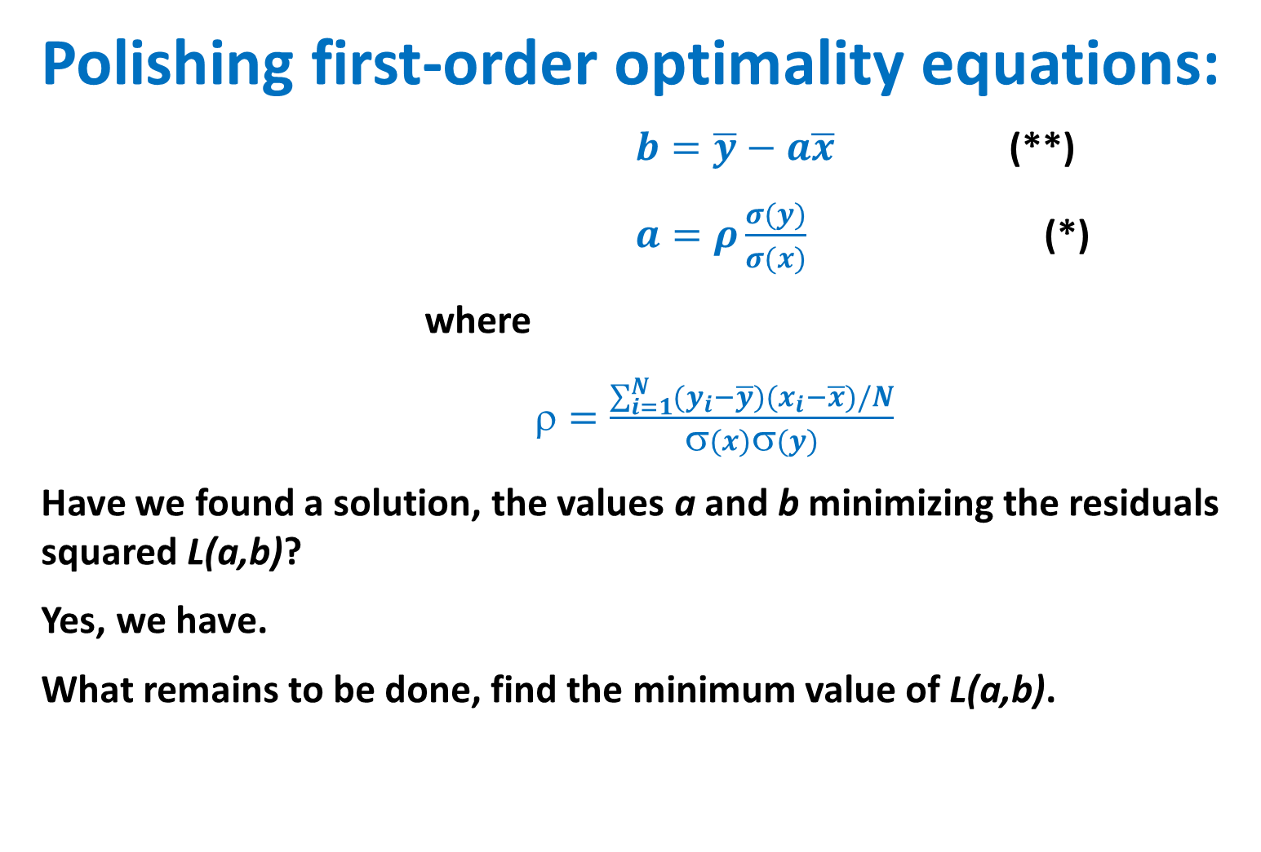
Week 7. 2D Linear regression 7
Polishing first-order optimality equations:
$b=\overline{y}−a\overline{x}$ (**)
$a=ρ\frac{σ(y)}{σ(x)}$ (*)
where
$=\frac{\sum_{i=1}^{N}{(y_{i}−\overline{y})}{(x}_{i}−\overline{x})/N}{σ(x)σ(y)}$
Have we found a solution, the values a and b minimizing the residuals squared L(a,b)?
Yes, we have.
What remains to be done, find the minimum value of L(a,b).

Slide 20
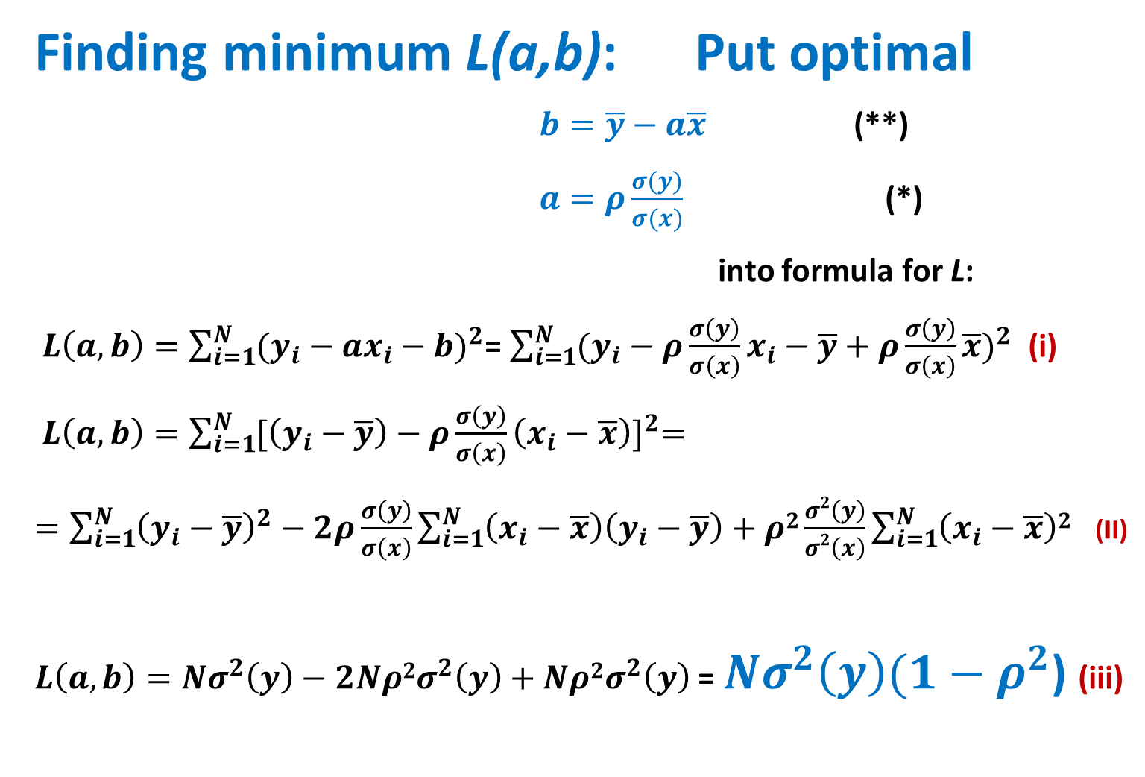
Week 7. 2D Linear regression 7
Finding minimum L(a,b): Put optimal
$b=\overline{y}−a\overline{x}$ (**)
$a=ρ\frac{σ(y)}{σ(x)}$ (*)
into formula for L:
$L\left(a,b\right)=\sum_{i=1}^{N}{{(y_{i}−ax_{i}−b)}^{2}}$= $\sum_{i=1}^{N}{{(y_{i}−ρ\frac{σ\left(y\right)}{σ\left(x\right)}x_{i}−\overline{y}+ρ\frac{σ\left(y\right)}{σ\left(x\right)}\overline{x})}^{2}}$ (i)
$L\left(a,b\right)=\sum_{i=1}^{N}{{[\left(y_{i}−\overline{y}\right)−ρ\frac{σ\left(y\right)}{σ\left(x\right)}\left(x_{i}−\overline{x}\right)]}^{2}=}$
$=\sum_{i=1}^{N}{{{\left(y_{i}−\overline{y}\right)}^{2}−2ρ\frac{σ\left(y\right)}{σ\left(x\right)}\sum_{i=1}^{N}{\left(x_{i}−\overline{x}\right)\left(y_{i}−\overline{y}\right)}+ρ2\frac{σ2\left(y\right)}{σ2\left(x\right)}\sum_{i=1}^{N}{\left(x_{i}−\overline{x}\right)2}}^{}}$ (II)
$L\left(a,b\right)=Nσ^{2}\left(y\right)−2Nρ{2σ}^{2}\left(y\right)+Nρ{2σ}^{2}\left(y\right)$ = $Nσ^{2}\left(y\right)(1−ρ^{2}$) (iii)

Slide 21
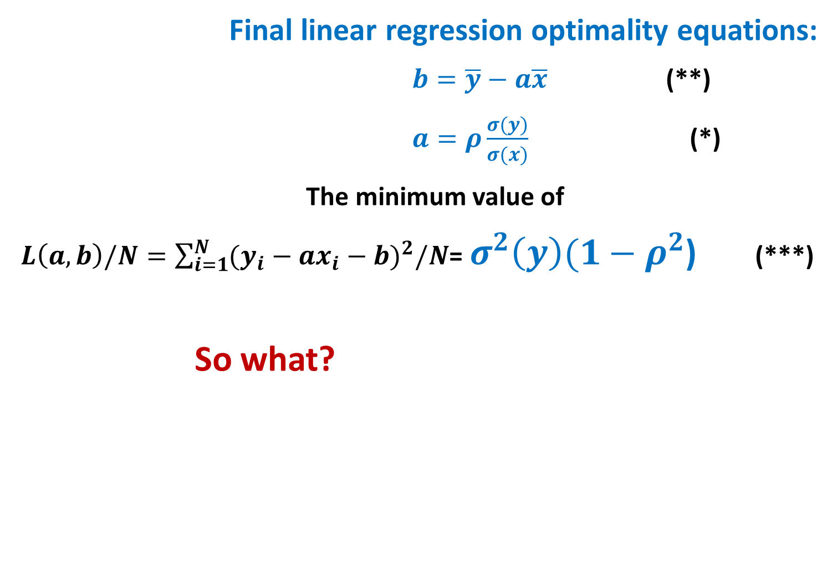
Week 7. 2D Linear regression: all solved
Final linear regression optimality equations:
$b=\overline{y}−a\overline{x}$ (**)
$a=ρ\frac{σ(y)}{σ(x)}$ (*)
The minimum value of
$L\left(a,b\right)/N=\sum_{i=1}^{N}{{(y_{i}−ax_{i}−b)}^{2}/N}$= $σ^{2}\left(y\right)(1−ρ^{2}$) (***)
So what?

Slide 22
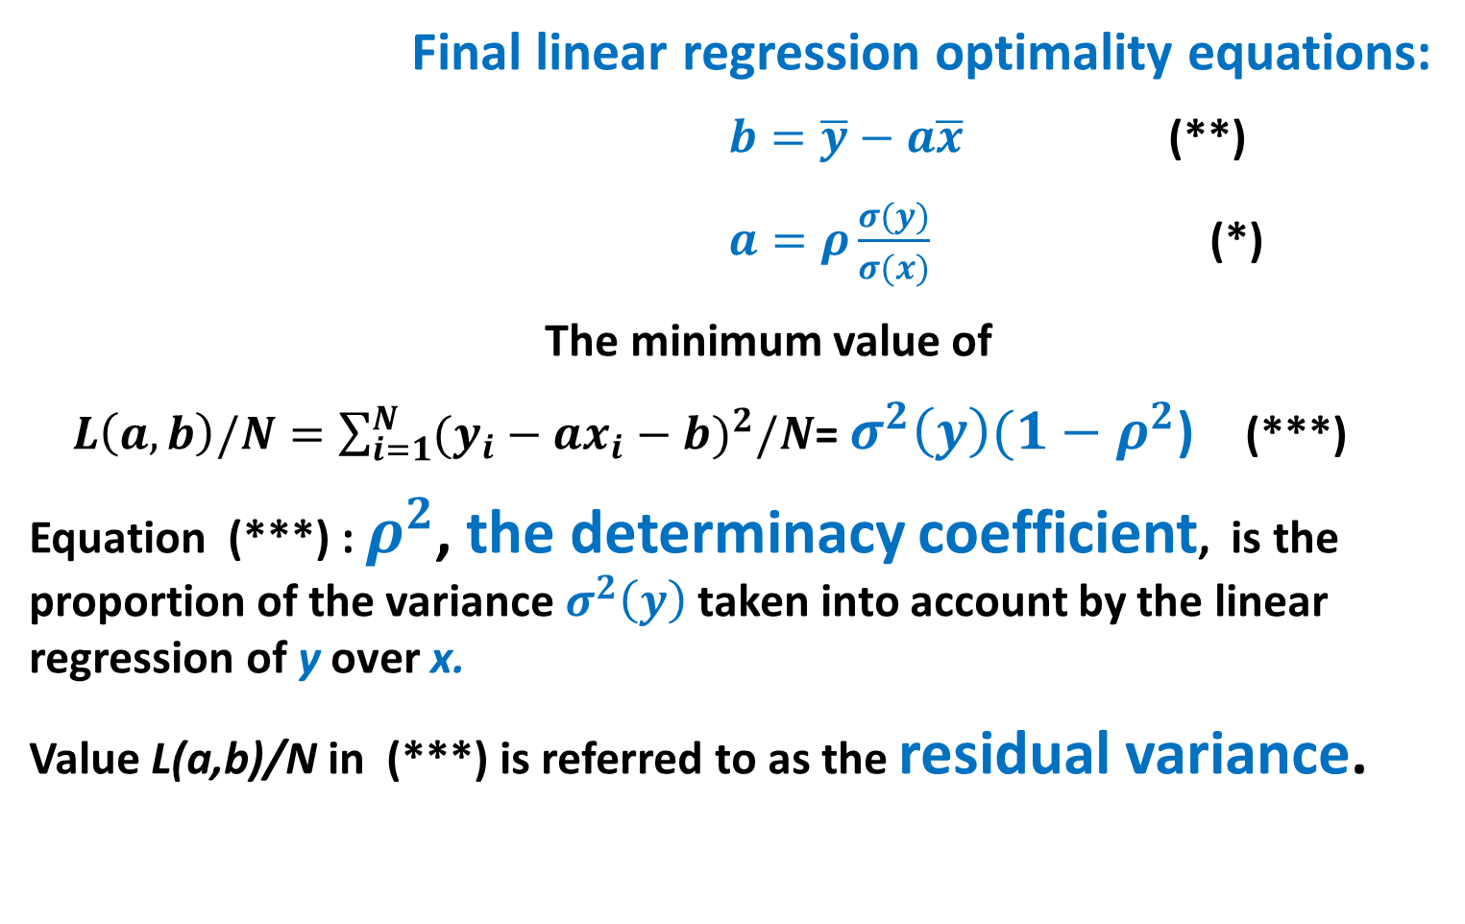
Week 7. 2D Correlation and determinacy coefficients: properties and meaning 1
Final linear regression optimality equations:
$b=\overline{y}−a\overline{x}$ (**)
$a=ρ\frac{σ(y)}{σ(x)}$ (*)
The minimum value of
$L\left(a,b\right)/N=\sum_{i=1}^{N}{{(y_{i}−ax_{i}−b)}^{2}/N}$= $σ^{2}\left(y\right)(1−ρ^{2}$) (***)
Equation (***) : $ρ^{2}$, the determinacy coefficient, is the proportion of the variance $σ^{2}\left(y\right)$ taken into account by the linear regression of y over x.
Value L(a,b)/N in (***) is referred to as the residual variance.

Slide 23
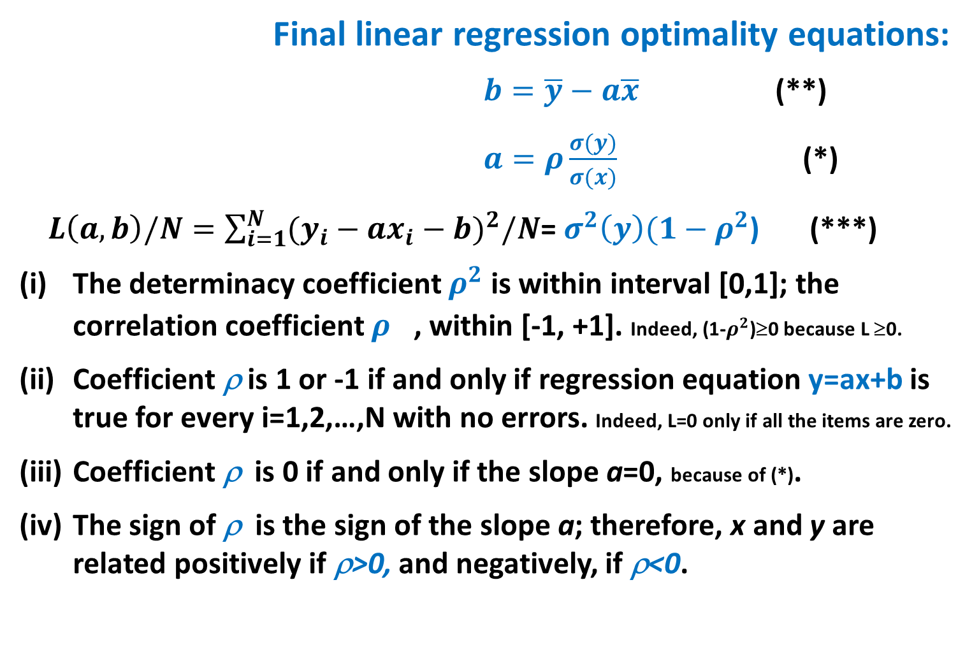
Week 7. 2D Correlation coefficient: four properties
Final linear regression optimality equations:
$b=\overline{y}−a\overline{x}$ (**)
$a=ρ\frac{σ(y)}{σ(x)}$ (*)
$L\left(a,b\right)/N=\sum_{i=1}^{N}{{(y_{i}−ax_{i}−b)}^{2}/N}$= $σ^{2}\left(y\right)(1−ρ^{2}$) (***)
The determinacy coefficient $ρ^{2}$ is within interval [0,1]; the correlation coefficient $ρ^{}$, within [-1, +1]. Indeed, (1-$ρ^{2}$)≥0 because L ≥0.
Coefficient ρ is 1 or -1 if and only if regression equation y=ax+b is true for every i=1,2,…,N with no errors. Indeed, L=0 only if all the items are zero.
Coefficient ρ is 0 if and only if the slope a=0, because of (*).
The sign of ρ is the sign of the slope a; therefore, x and y are related positively if ρ>0, and negatively, if ρ<0.

Slide 24
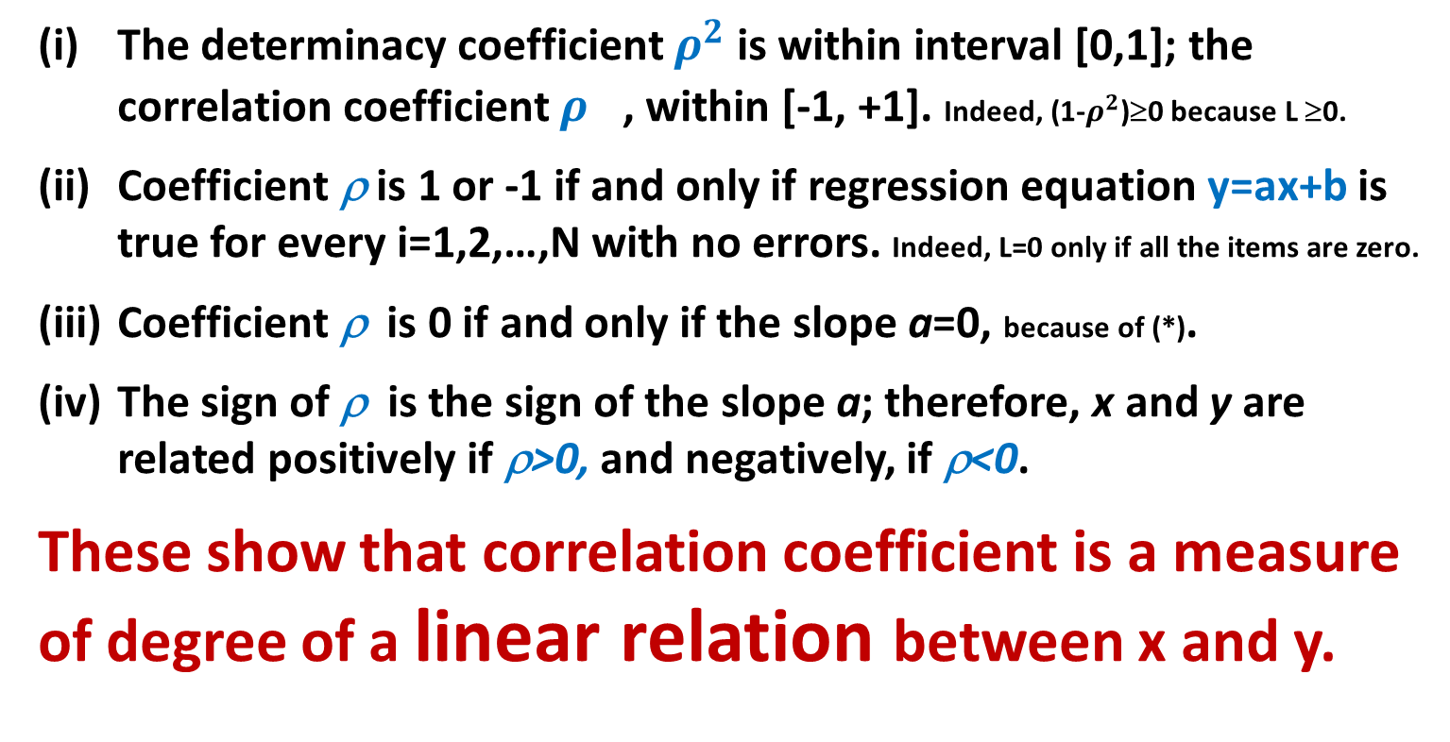
Week 7. 2D Correlation coefficient: properties and meaning 2
The determinacy coefficient $ρ^{2}$ is within interval [0,1]; the correlation coefficient $ρ^{}$, within [-1, +1]. Indeed, (1-$ρ^{2}$)≥0 because L ≥0.
Coefficient ρ is 1 or -1 if and only if regression equation y=ax+b is true for every i=1,2,…,N with no errors. Indeed, L=0 only if all the items are zero.
Coefficient ρ is 0 if and only if the slope a=0, because of (*).
The sign of ρ is the sign of the slope a; therefore, x and y are related positively if ρ>0, and negatively, if ρ<0.
These show that correlation coefficient is a measure of degree of a linear relation between x and y.

Slide 25

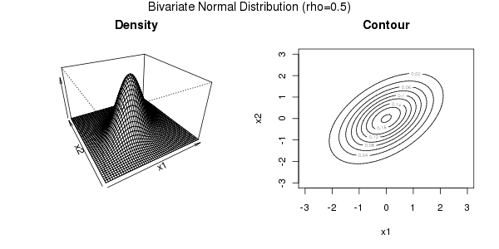
Week 7. K. Pearson’s highly creative insight (probabilistic perspective at Correlation coefficient: )
At the standard Multivariate Gaussian Bivariate case
f(u, ∑)= Cexp{-u^{T}∑ ⁻¹u/2} where u=(u₁,u₂, …, u_{v}); after z-scoring
K. Pearson: Correlation coefficient is a sample-based estimate of the parameter ρ in the Gaussian density function under the conventional assumption of independent random sampling.

Slide 26
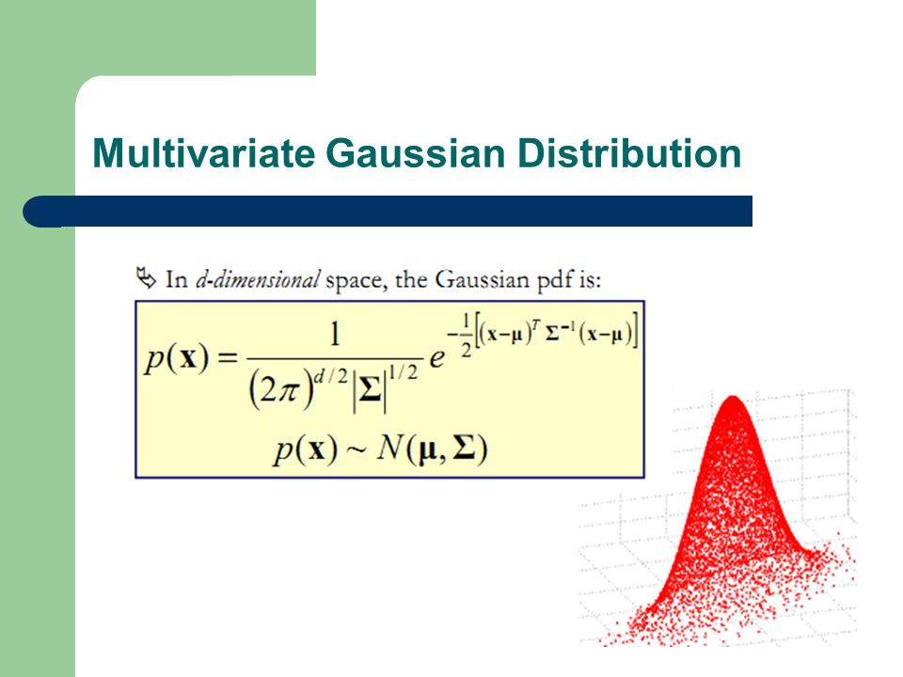

Slide 27

Week 7. Meaning of ρ =0: No relation?
$a=ρ\frac{σ(y)}{σ(x)}$ (*)
(iii) Coefficient ρ=0 if and only if the slope a=0 in the regression.
Here are 3 different reasons:
so that regression is y=b.
Random cloud Non-linear y=ax²+b Highly nonhomogeneous

Slide 28

Week 7. Meaning of ρ : Good Case
Iris Petal Width through Petal Length y=a*x+b
$b=\overline{y}−a\overline{x}$ (**)
$a=ρ\frac{σ(y)}{σ(x)}$ (*)
>> x=iris(:,3);
>> y=iris(:,4);
>> ρ =corr(x,y)% ρ =0.9629
Even inspite that points (x_{i},y_{i})
are not exactly on a line, determinacy ρ ²=92.7% (7.3% of y-scatter left unexplained)
slope = 0.4158
intercept = -0.3631 (red line)

Slide 29
Week 7. Meaning of ρ : High determinacy warrants no high precision:
Iris Petal Width=0.4158*x- 0.3631 (ℵ)
Although points (x_{i},y_{i}) do not fit
the regression line, ρ²=92.7% -
Very high!
Test for the errors at prediction
n. x y PWℵ error,%
23 1.4 0.1 0.22 119.0
51 4.5 1.5 1.51 0.5
86 4.3 1.3 1.42 9.6
138 5.0 1.9 1.72 -9.7
142 5.7 2.5 2.01 -19.7 Average precision 20.6% (s=25.8)

Slide 30
Week 7. Correlation: weird case1,1
Iris Sepal Length and Sepal Width (other pair)
This is highly unnatural.
The SL and SW should go
along, with a positive,
if not high, correlation.

Slide 31
Week 7. Correlation and regression: Weird case 1, 2
Iris Corr(Sepal Length, Sepal Width)=-0.1176
This highly unnatural value
comes from the non-homogeneity:
a mix of three taxa
correlation within each,
0.74, 0.53, 0.46,
is positive, if not quite high

Slide 32
Week 7. Correlation and regression: Weird case 1, 3
A scheme of FALSE negative correlation by merging different groupings
A high positive correlation within each
group, red, blue, grey; yet a negative
correlation overall !!!
Instances of data manipulation, sometimes
unintentional, should have made
great politicians
(B. Disraeli, UK Prime-Minister) to say
even if they have not:
THREE LEVELS of LIE: “A LIE, DAMNED LIE, and STATISTICS!”,

Slide 33
Week 7. Correlation : Weird case 1, 4 A quiz
A scheme of FALSE POSITIVE correlation by merging different groupings
A high NEGATIVE correlation
within each group;
yet a positive
correlation overall !!!
THREE LEVELS of LIE: “A LIE, DAMNED LIE, and STATISTICS!”,
Can you guess a proper picture for this?
Try proposing a scatter-plot for this case.

Slide 34
Week 7. Correlation and regression: Weird Case 2
Another case, of inflated correlation:
Random features generated:
>> g=rand(200,1);
>> h=5*rand(200,1)-3;
>> plot(g,h, 'k.')
>> corr(g,h) =0.06 % close to 0

Slide 35
Week 7. Correlation and regression: Weird Case 2, 2
Another case, of inflated correlation, by adding outliers:
Random features generated:
On the left:
>> g=rand(200,1);
>> h=5*rand(200,1)-3;
>> rho=0.0650
On the right
TWO outliers are added:
>> g(201)=100; g(202)=-100;
>> h(201)=-100; h(202)=-90;
>> rho=0.9862 % almost a unity!

Slide 36
Meaning of correlation coefficient
A high value of ρ does not warrant any good precision of the regression
Value of ρ can be inflated by adding a few outliers
Zero value of ρ does not warrant low association between a target and predictor – this may indicate either
High non-homogeneity
High non-linearity

Slide 37
Nature-inspired approach to regression: cases non-linearity or different criteria
Relative error to minimize
Δ(i)=|y_{i}-ax_{i}-b|/|y_{i}|
Σ_{i}Δ(i) ⇒ min _{a, b}
A very complex function; no good methods of classical styles: take an admissible solution, then hone and polish it

Slide 38
Nature-inspired approach for criterion Σ_{i}Δ(i) ⇒ min _{a, b} with Δ(i)=|y_{i}-ax_{i}-b|/|y_{i}|,1
Rather than honing a single admissible solution, run a nature-inspired evolutionary process for a population of admissible solutions
First find an area A of admissibility for pairs (a,b)
Take a population of random p admissible pairs (a(k),b(k)), k=1,2,…,p.
Define rules for: (1) the population to evolve, (2) elite maintenance, (3) halt.
Run an evolution process according to the rules.

Slide 39
Nature-inspired approach for Σ_{i}Δ(i) ⇒ min _{a, b} with Δ(i)=|y_{i}-ax_{i}-b|/|y_{i}|, 2
Find an area A of admissibility. At each i,j=1,…,N, take a(ij), b(ij) from yi=a(ij)xi+b(ij), yj=a(ij)xj+b(ij): a(ij)=(yi-yj)/(xi-xj), b(ij)=yi-a(ij)xi. Sort all a(ij) and b(ij), remove upper and lower percentile t%(about 15%) in intervals [a1,a2] and [b1,b2], so that A=[a1,a2] ×[b1,b2].
Take a population, that is, p × 2 array f of random p pairs (a(k),b(k)) from A, k=1,2,…,p.
Define rules for:
(1) the population to evolve:
(1a) take the average a and b over the population and replicate them p times in p×2 array mf, (1b) define fn=f+randn(p,2).*mf/20, (1c) trim fn to remain in A as array fr;
(2) Elite policy
(2a) find in f the best pair (a*,b*) [elite], store it, and replicate it in p × 2 array el;
(2b) define next generation array f’=0.7fr+0.3el and go to step 1 with f=f’. Change the elite if current (a*,b*) are better than those stored.
(3) Halt after 10000 iterations and output (a*,b*).

Slide 40
Nature-inspired approach for the least squares with y=ax^{b} , 1
Find an area A of admissibility, as above, by the linearized equation log(y)=log(a)+blog(x) by using transformed variables z=log(y) and v=log(x), so that the equations are about z(ij) and v(ij).
Run the nature-inspired process above.
Example: take x and y generated as follows: x=10*rand(1,50),
for i=1:50;yy=2*x(i)^1.07+2*randn; y(i)=max(yy,1.01); end;

Slide 41
Nature-inspired approach for the least squares with y=ax^{b} , 2
Example: Generate
x=10*rand(1,50),
for i=1:50;yy=2*x(i)^1.07+2*randn; y(i)= yy⏐1.01; end;
Nature Inspired process results: a = 2.0293, b = 1.0760, the average squared error = 0.0003
Linearized regression z=c+bv results : a = 3.0843, b = 0.8011, the average squared error 4.41.
Most important: a wrong regularity: b=0.8 is less than 1, whereas the generated b=1.07.

Slide 42
Week 7. SUMMARY
Scatter plot: just a Cartesian representation in 2D
Correlation coefficient: 3 perspectives
Linear regression: a convenient format to summarize relation between two features
Determinacy and correlation in the approximation perspective: due to the linearity and least-squares criterion; ρ² scoring the extent of y-variance taken into account; ρ expressing, vaguely, the extent of linear relation between x and y
Correlation and regression: Useful, but be aware of non-homogeneity [“just lies, damned lies, and statistics”].
Different function and/or different criteria: Nature-inspired optimization

Slide 43
Homework 5
1. Find two features in your dataset with more or less “linear-like” scatterplot.
2. Display the scatter-plot.
3. Build a linear regression of one of the features over the other. Make a comment on the meaning of the slope.
4. Find the correlation and determinacy coefficients, and comment on the meaning of the latter.
Make a prediction of the target values for given two or three predictor’ values; make a comment
Compare the mean relative absolute error of the regression on all points of your set and the determinacy coefficient and make comments

